Slide 1
From Punch Cards to Git
A Brief History of Version Control
https://github.com/CuriousCurmudgeon/history_of_vcs
Notes:
Good morning. How is everybody doing? I would like to thank you for waking up early after the waterpark party last night and joining me this morning on the last day of CodeMash.

Slide 2

Brian Meeker
@CuriousCurmudge
Notes:
My name is Brian Meeker. I'm a software developer for InfernoRed Technology. I work as a consultant, mostly in .NET and JS/Typescript, but also a bunch of other things. My official title is Engineering Wizard, but I'm a jack of all trades, master of none kind of guy.

Slide 3

Look for the dragon right outside of Salon A.
Notes:
Stop by the InfernoRed booth if you want to chat about this talk or any other cool stuff you've seen at CodeMash this week.

Slide 4
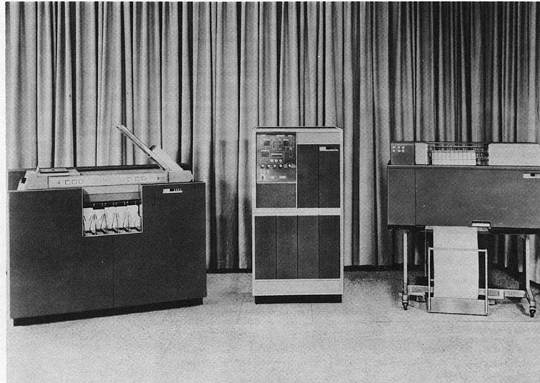
https://en.wikipedia.org/wiki/IBM_1400_series#/media/File:BRL61-IBM_1401.jpg
Notes:
So, you're here for a history talk. What makes me qualified to give a history talk? This is me putting my imaginary history minor to use. You see, I took all the courses to get a history minor, but never actually talked to anybody in the history department about it, so... no minor for me. But I put in all the work, and I think that's the important part. I'm pretty sure that avoiding the paperwork and the human interaction required to complete a task is the most stereotypical software developer behavior you can imagine.
And for the curious, from left to right those are a
IBM 1402 Card Read Punch, Model 1 - $24,800
IBM 1401 Processing Unit, Model A-1 - $70,500
IBM 1403 Printer, Model 1 - $30,300
Total Price $125,600 (in 1961)
Apparently, the Computer History Museum has two working 1401’s.
The other motivation for this talk came from CodeMash last year. I want to thank Jenny Manning for doing her talk at last year's CodeMash - Mommy, where do new programming languages come from? last year. Her talk was the inspiration for me submitting this talk and speaking here this year.

Slide 5
What is version control?
…the management of changes to documents, computer programs, large web sites, and other collections of information.
- https://en.wikipedia.org/wiki/Version_control
Notes:
I am not above stooping to Wikipedia for definitions. This one is pretty straightforward and probably matches your intuition about what version control is.

Slide 6
What is version control?
…a system that records changes to a file or set of files over time so that you can recall specific versions later.
- https://git-scm.com/book/en/v2/Getting-Started-About-Version-Control
Notes:
I’m also not above pulling definitions from the official Git book as part of their documentation. I like that this version specifically calls out recalling specific versions later.
You'll notice these definitions don't lay out any specific requirements about what features a version control system needs to have. We would certainly like it to be easy to visualize changes. We would certainly like to have atomic commits. We would certainly like it to be easy to manage releases. But none of these are required. You just need to record changes so you can get back to a specific version if needed. That's it.
There are also a couple of different terms for version control.
VCS = Version Control Software/Version Control System
SCM = Source Control Management/Software Configuration ManagementRevision Control
Revision Control
Sometimes you’ll here VCS. Sometimes SCM. Occasionally revision control. I’m going to try and be consistent here and use the term “version control”, but I could slip up.
Any distinction between these terms is generally meaningless. Software Configuration Management can have a slightly different meaning depending on context, but that isn't important in the context of this talk.

Slide 7
Out of Scope
Hosting services (SourceForge, GitHub, Bitbucket, etc.)
Integrated version control
Wikis
Most commercial systems
Notes:
We only have so much time, so these items are mostly out of scope.
* Repository hosting services like Sourceforge, GitHub, and BitBucket.
* Integrated version control, like you see in modern word processors, spreadsheets, or content management systems.
Wikis
Most commercial systems, with one important exception. There are a lot of commercial systems over the years, but I’ve cut all of them except one for time reasons. There is only so much time to go over all of these.
These things are all important in the history of version control, but they are out of scope for this talk. We're going to focus on the tools that have been primarily used by development teams.

Slide 8
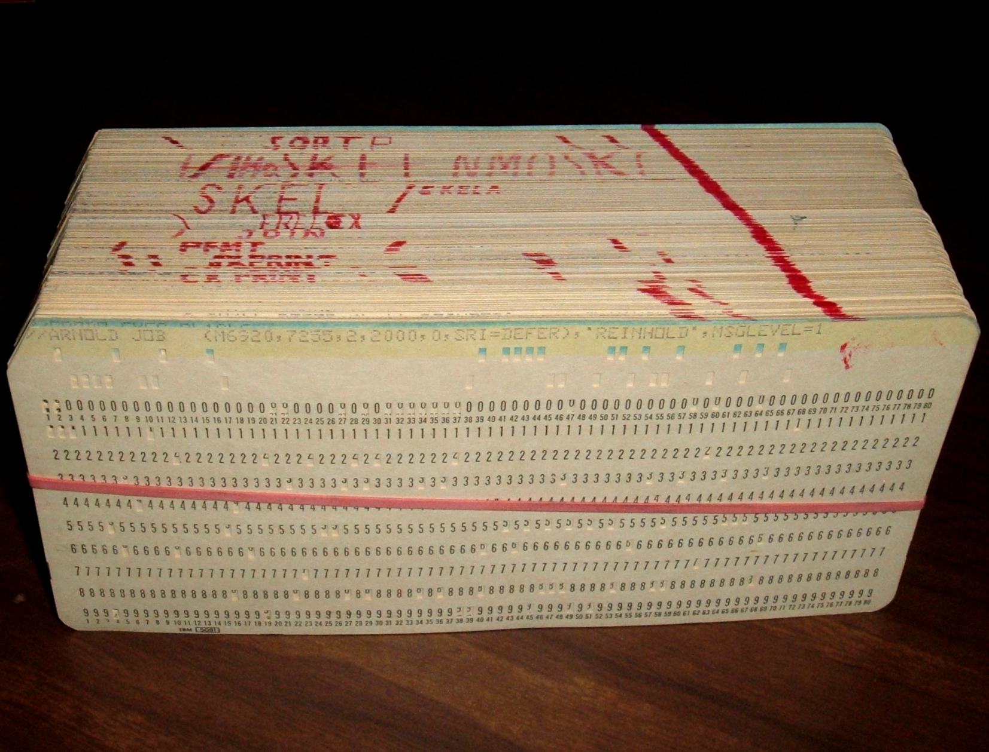
Punch Cards
https://commons.wikimedia.org/wiki/File:Punched_card_program_deck.agr.jpg
Notes:
Can anybody tell me what this is?
Has anybody here actually used these before? Looking around the room, I feel pretty confident that the answer for just about everybody is no. If anybody has, can you tell me when you used them and where?
Fun fact, the title of this talk has ”punchcards” as one word. This may surprise you given my quickly greying status, but I’m not old enough to have ever used punch cards. From what I was able to find “punchcards” as one word is acceptable, but two words is more common. And “punched cards” is also a thing and arguably the correct way to say it if your card has already been punched.
So, how do you think you would organize these? Do you think it's possible to have any concept of version control?
The answer to the second question is, not really. Given two decks of punch cards, there isn't an easy way to diff them. There were machines to duplicate a punch card deck, but not anything that would compare them as far as I know.
So, I think the best we can do is talk about how a programmer would maintain his punch card deck with the understanding that it is not version control.

Slide 9
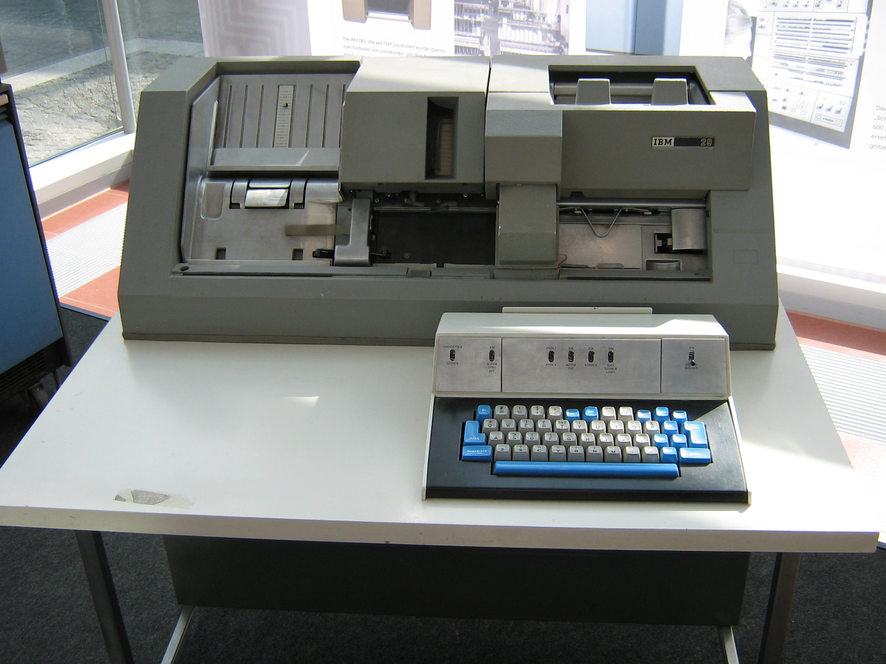
Keypunch Machine
https://en.wikipedia.org/wiki/Keypunch#/media/File:IBM_card_punch_029.JPG
Notes:
Does anybody know what this is? This is a keypunch machine. After writing your program on coding sheets, you would take your sheets over to a keypunch operator, usually a woman. The keypunch operator would use this machine to turn your written source code into something that could be fed into a computer.
This model specifically is the IBM 029 Key Punch. It was introduced in 1964 at the same time as the IBM 360.

Slide 10
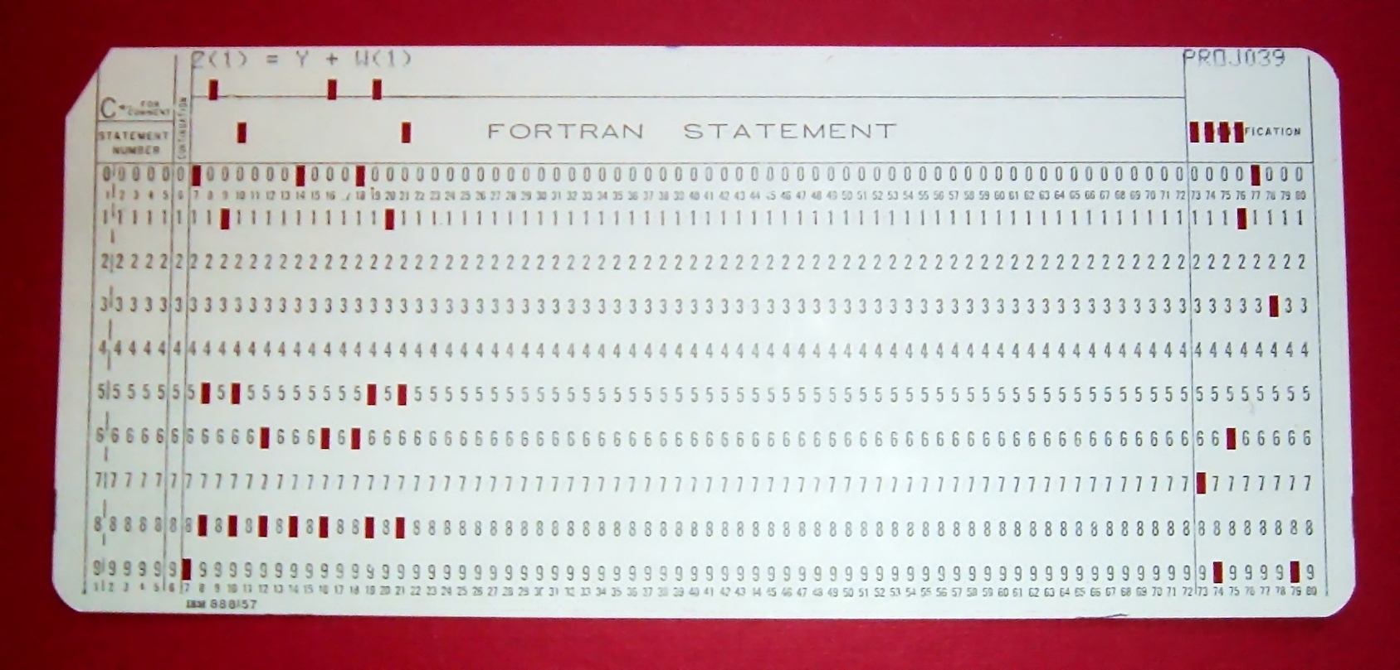
Running Your Program
https://commons.wikimedia.org/wiki/File:FortranCardPROJ039.agr.jpg
Notes:
So, now you have punch cards for your program, but could a computer directly run these punch cards? Look closely at the top of the card here. What do you see? Source code. The punch cards from the keypunch machine are just your source code in a format that can be fed into the computer. And what do we do with source code before the machine actually runs it? We compile. Some languages today still make this an explicit step. Some do it implicitly, but the code is always compiled before the machine can run it.

Slide 11
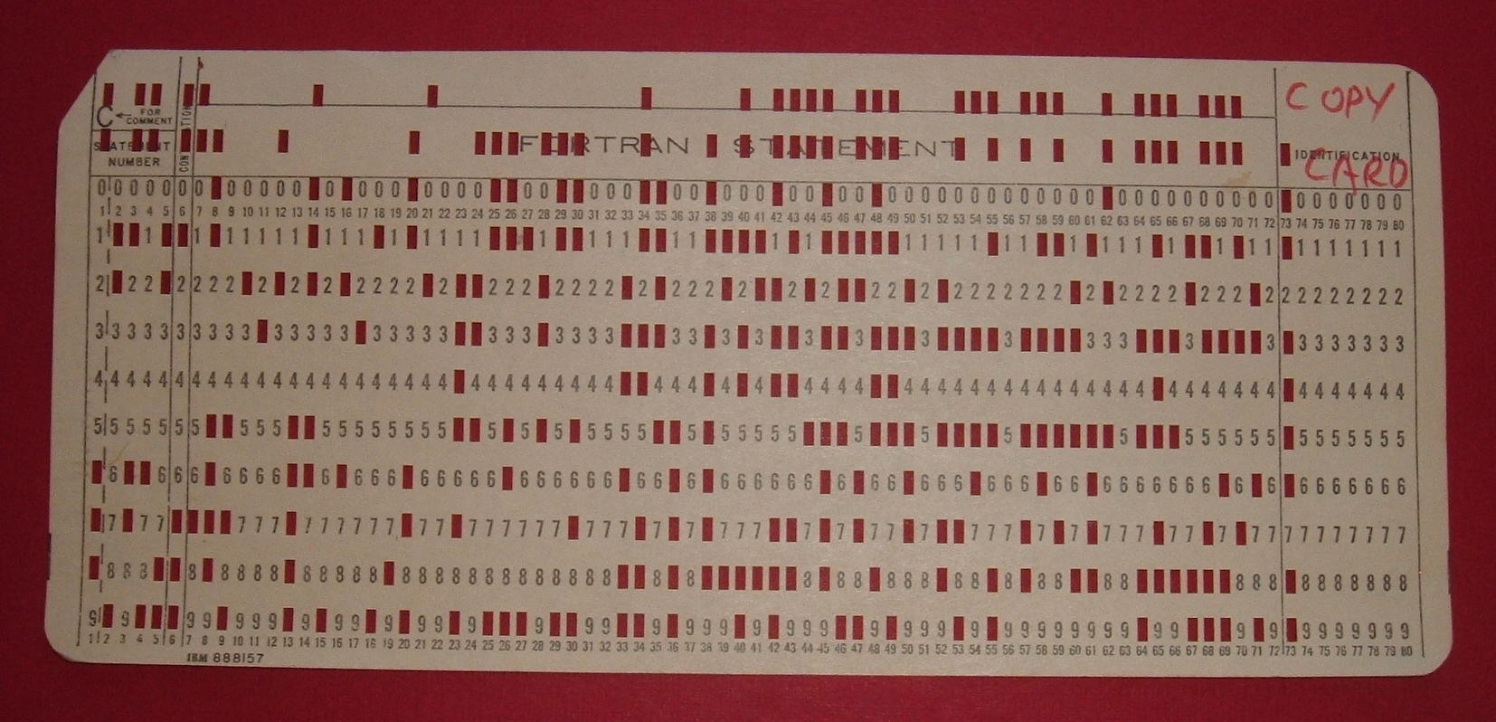
Compiled Punch Card
https://commons.wikimedia.org/wiki/File:IBM1130CopyCard.agr.jpg
Notes:
So you would take your punch card deck to the computer operator and they would attempt to compile it for you.
This particular compiled card contains a self-loading IBM 1130 program that would copy the deck of cards placed after it in the input hopper.
If you were incredibly lucky/good/fortunate to have a simple task, then your program would compile the first time. Let's assume it did compile correctly though. Next, the computer operator would load your deck of compiled punch cards into the machine to execute the program. You would then get your original deck, compiled deck, and printed output back.
Now, chances are good that your program didn't work correctly the first time. It almost never does and you have to remember that these programmers had no real time feedback. There was no test suite running constantly. No debugger. No IDE. Nothing. So, now we can finally get to the real problem. How did a programmer manage changes to their punch card deck?

Slide 12
Notes:
First, your helpful keypunch operator would often draw a diagonal line like this across the top of your cards. Now, if you dropped your deck, you could put it back in order by recreating the line. Not the most reassuring of systems, but it was a nice start for a new deck.
There was also a machine to quickly create a copy of your deck, a punched card duplicator.
But what would happen when you start making edits to your deck. The keypunch operator shouldn't have to type up a new copy of your deck every time you make a change. As a programmer, you should be able to type up a new card as needed to insert into your deck. However, your line won't be very useful in that case. It will quickly become a jagged mess.

Slide 13
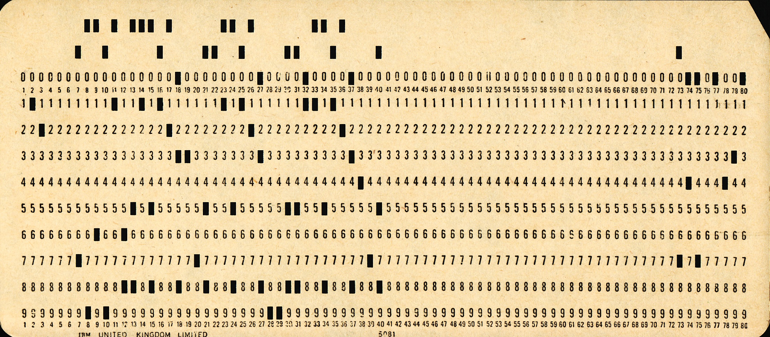
Sequence Numbers
PUX 430
https://commons.wikimedia.org/wiki/File:Used_Punchcard_(5151286161).jpg
Notes:
Does anybody know how many columns there are on a standard punch card? 80. If you look closely at this card, you will see the columns labeled at the bottom all the way to 80. However, it was common practice for compilers to only look at the first 72 columns on the card. So, that gives us 8 unused columns and those columns are the key to ordering the deck.
I did not spend the time to get good at reading these cards, but apparently this is another Fortran card with the sequence number “PUX 430”

Slide 14
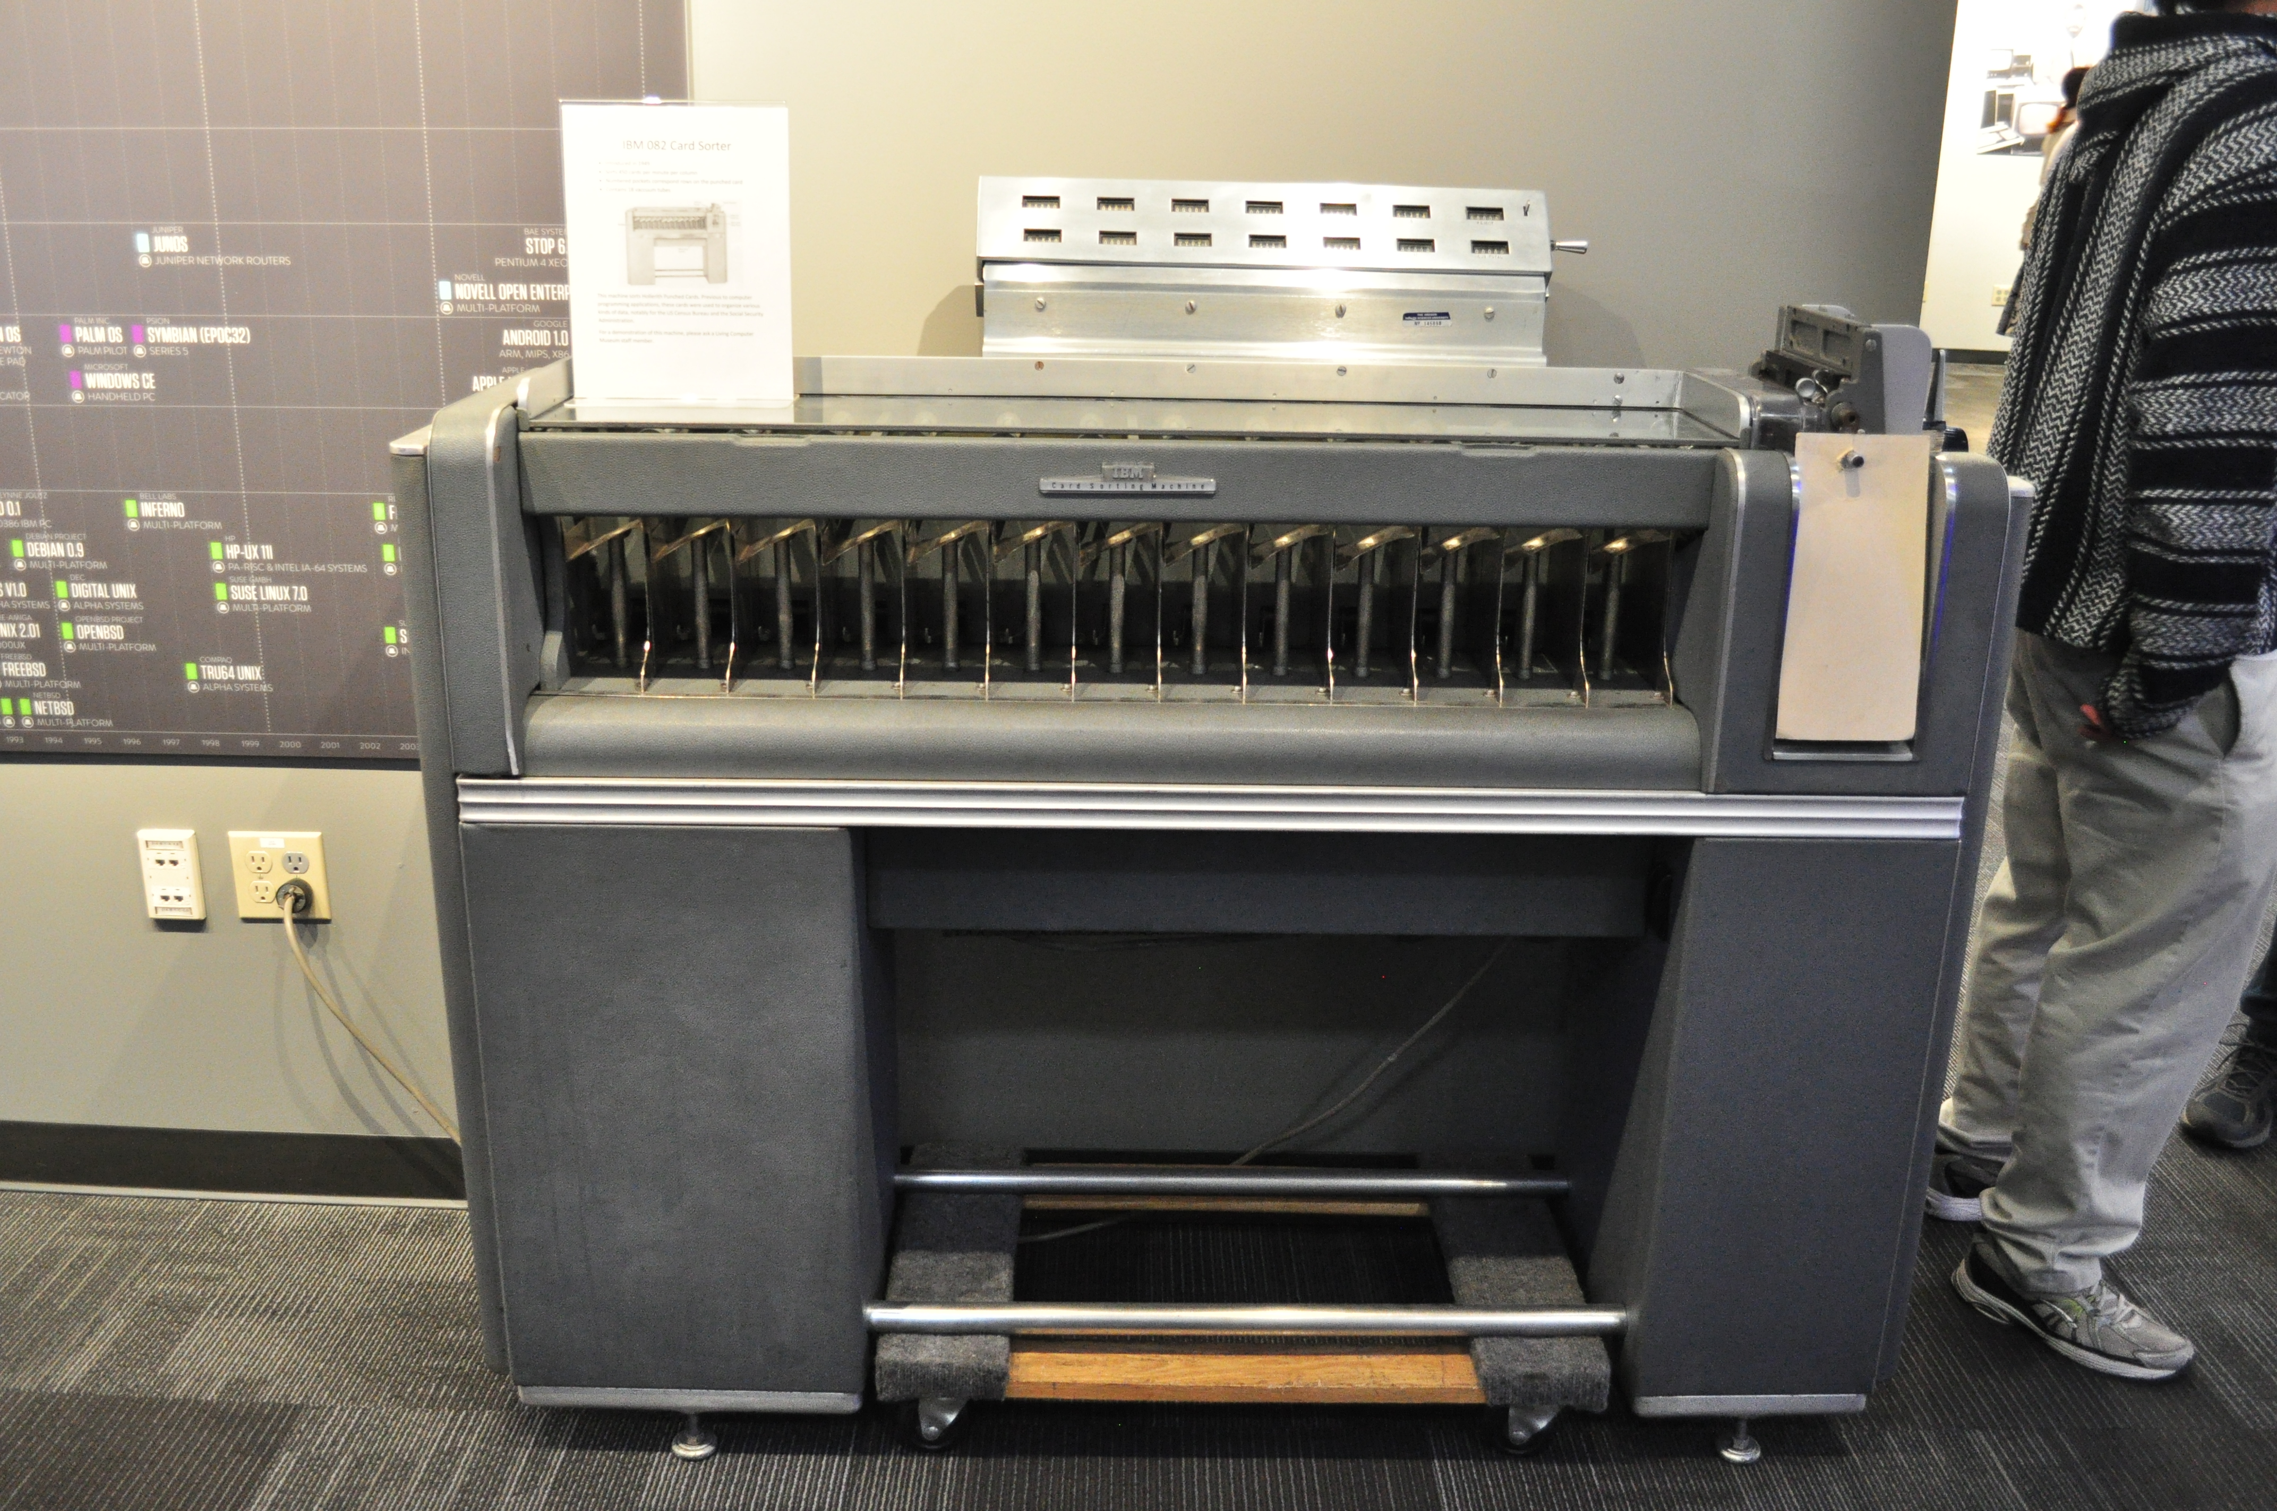
Punch Card Sorter
https://commons.wikimedia.org/wiki/File:LCM_-_IBM_082_Card_Sorter_01.jpg
Notes:
This is an IBM 082 card sorter at the Living Computer Museum in Seattle. This model came out in 1949 and could sort 650 cards per minute.
That kinds of just shifts the problem around though. What if we have our sorted deck and we want to insert a new card in the middle of our program. For example, we want to insert a new card 32 and shift the rest of the deck back. How do we easily renumber our cards? Easy, you write a program for it. That’s exactly what the compiled card we saw earlier was. So you feed your deck into the machine in the new order. The machine ignores the existing sequence numbers and copies your deck with new sequence numbers.
There are still a lot of limitations here. Getting new sequence numbers is automated, but if you put a card in the wrong spot in the deck you won't have any record of that. Depending on how long you needed to wait for computer time, you might notice before you compile. If you don’t catch the error then you'll have to compile and, if it compiles successfully, execute your program to recognize your mistake.
There's also no trail of any changes. Collaborating with another programmer on a problem is very difficult. You would have to very, very carefully negotiate who is working on what. And even when working by yourself, you can't look at your history and figure out where you introduced a bug.

Slide 15
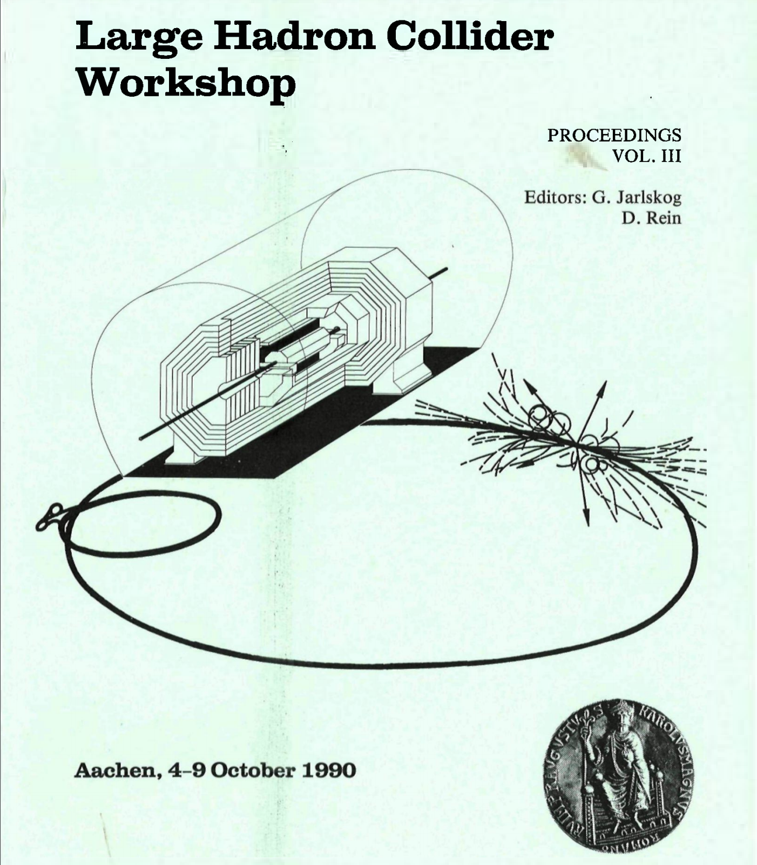
https://inis.iaea.org/collection/NCLCollectionStore/_Public/22/031/22031927.pdf
Notes:
For awhile while putting together this talk I thought that the punch card sorter was the end of the line. Then I stumbled upon the proceeding from a Large Hadron Collider workshop in October 1990. On a side note, anybody who followed the development of the LHC should be amused to see proceeding from a workshop on it from 1990. Construction on it didn’t start until 1998 and it didn’t come online until 2008.

Slide 16
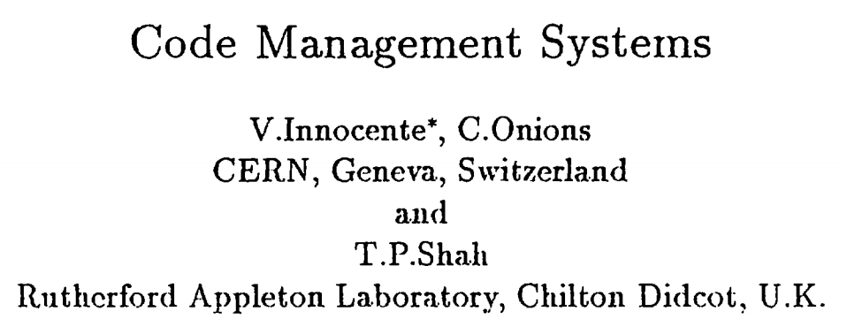
Notes:
Anyways, back to the actual topic. These proceedings contain a summary of “code management systems” being used by CERN researchers. The first system they mention is called PATCHY which at the time was the most widely used ”code manager” in the high energy physics community.

Slide 17
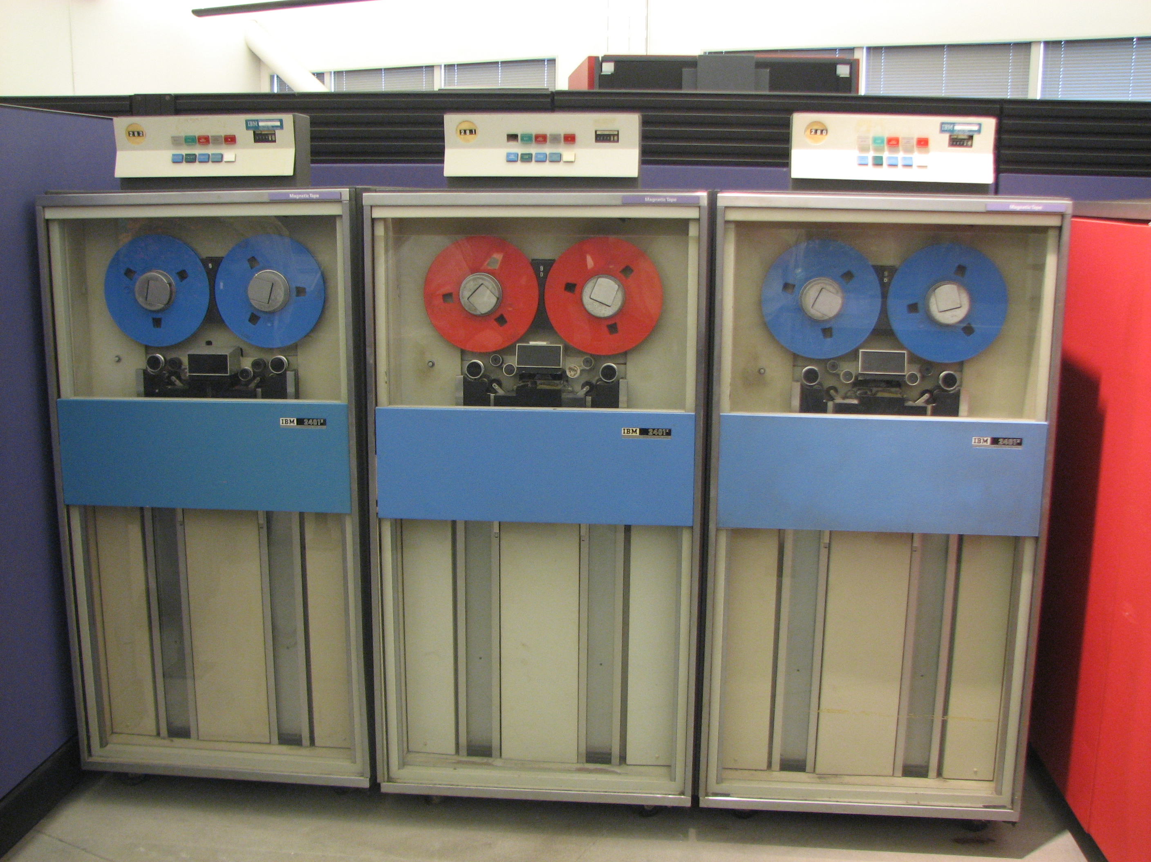
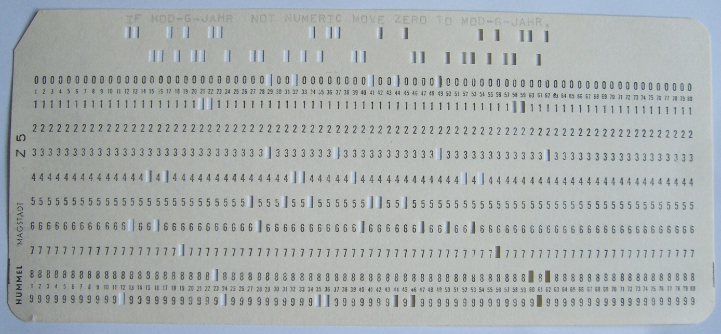
PATCHY
https://en.wikipedia.org/wiki/9_track_tape#/media/File:IBM_System_360_tape_drives.jpg
https://commons.wikimedia.org/wiki/File:Punch-card-cobol.jpg
Notes:
PATCHY [1] was developed at CERN around 1965 at a, time when programs
were fed to the computer via a card reader. By maintaining the source code
in a PATCHY Master file (PAM) on tape and using a small cradle of update
cards the user was freed from the burden of reading in a tray full of cards! It
reads in and acts upon several sequential files by means of cards. PATCHY,
because of its origins, is not an interactive program at all. Because it accesses
the data sequentially PATCHY is necessarily slow or cumbersome in those
faclities best provided by random access.
PATCHY handles common sequences well and conditional code can also
be managed but in a slightly more complicated manner. History of code development can only be maintained if all changes are made via correction decks
at the start of the PAM file. In particular, if source code is modified directly
using the local editor then no history is available (unless done manually by
way of a comments deck at the start); there is no automatic way of going back
to an earlier version in this case. The updating process cannot be controlled
or monitored in any way. PATCHY is very good for distributing code to other
sites on tape and correction decks can be circulated for the PAM files in other
centres but no guarantee that they would apply to the correct version(s) of
the PAM file. PATCHY, as already mentioned, has been the most widely used code manager in the HEP community.

Slide 18
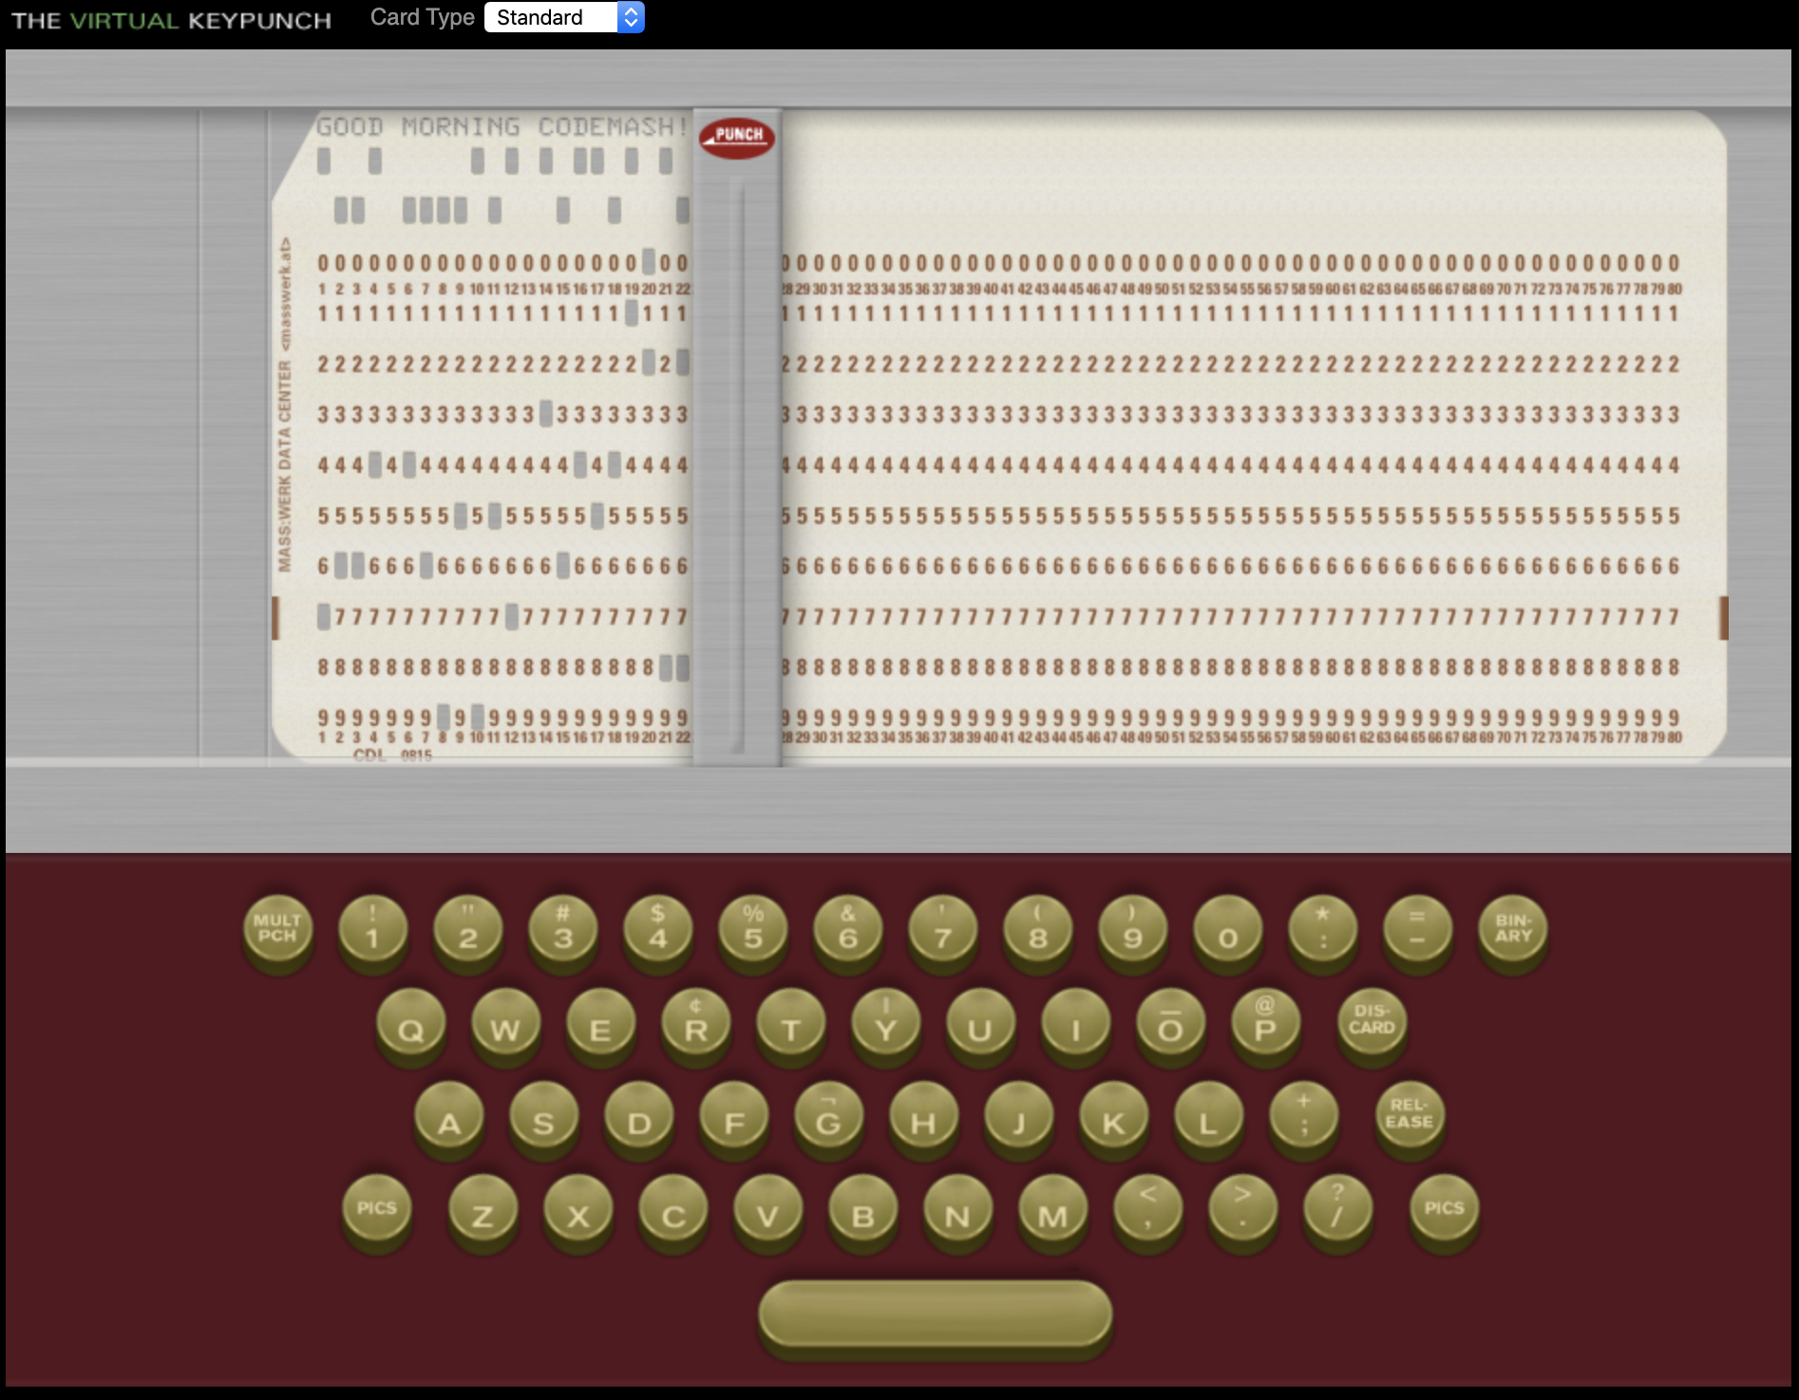
https://www.masswerk.at/keypunch/
Notes:
If you want to play around with punch cards yourself, I highly recommend The Virtual Keypunch. Things clicked a lot better for me once I could sit there and virtually type on the keyboard.
But, as far as I can tell, this as far as the punch card world got. Punch cards weren't long for this world though. We were about to enter the world of multi-user operating systems and teletypes. Pretty soon punch cards would begin to fade out and source code would live on the computer itself. Which meant it was time to start looking into software to manage it.

Slide 19
Generations
Generation | Networking | Operations | Concurrency | Examples
First | None | One file a time | Locks | SCCS, RCS
Second | Centralized | Multi-file | Merge before commit | CVS, SVN
Third | Decentralized | Changesets | Commit before merge | BitKeeper, Monotone, Darc, Git, Mercurial
https://ericsink.com/vcbe/html/history_of_version_control.html#ftn.idp96624

Slide 20
Source Code Control System
SCCS
Notes:
Like most ideas, there are a lot of pre-cursors that had some elements of version control, but it's widely agreed that SCCS (Source Code Control System), not to be confused with SCSS, is the first true version control system. The systems that existed before SCCS were mostly about deltas. And while deltas are extremely valuable, they do not make a version control system.

Slide 21
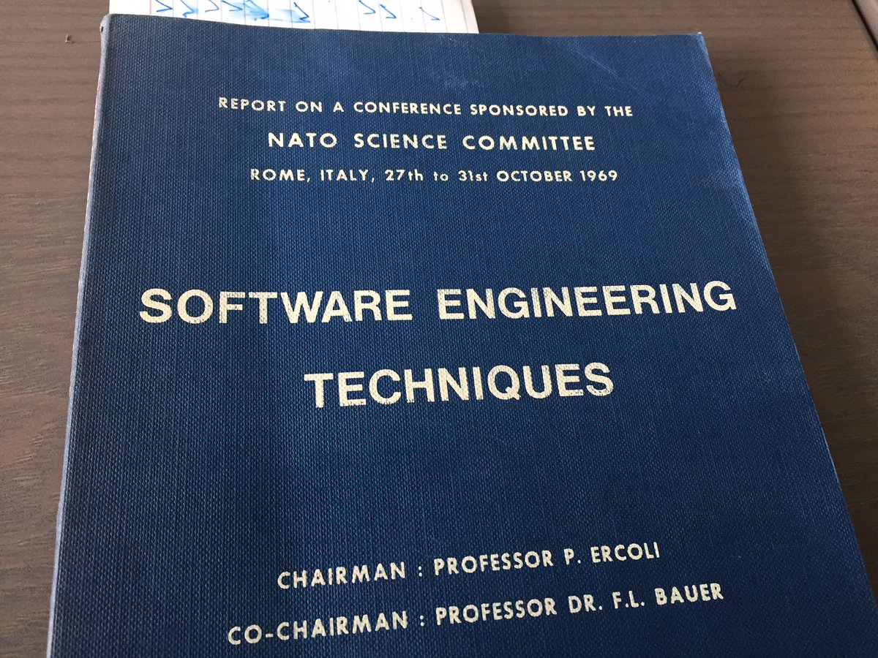
https://twitter.com/bokmann/status/893225721556078592
Notes:
Unfortunately, my research failed me when trying to find any detailed information about pre-cursors to SCCS. I know that systems like IBM's CLEAR (Controlled Library Environment and Resources) and DEC's CMS existed, but I wasn't able to find out much beyond that.
There is a little bit of information about CLEAR from a software engineering technique's conference sponsored by the NATO Science Committee in 1969. CLEAR was a larger system that "tried to assist with the administration and accomplishment of the program development cycle." (http://homepages.cs.ncl.ac.uk/brian.randell/NATO/nato1969.PDF pg. 40) One part of that system used deltas to help with versioning releases, but I was not able to find any other information.
And to go on even more of a tangent, there were two NATO software engineering conferences, this one and one the year before in 1968. The term “software engineering” was not in general use yet. Using the term for to title these conferences was an important step in the giving the term legitimacy.

Slide 22
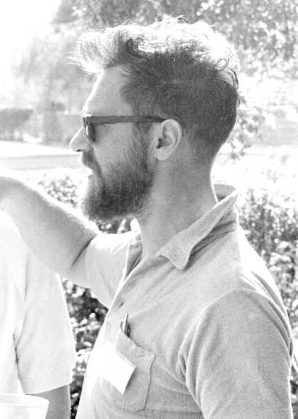
E.W. Dijkstra
Modern Hipster?
http://homepages.cs.ncl.ac.uk/brian.randell/NATO/N1969/DIJKSTRA.html
Notes:
And going even further off the deep end, this is a picture of E.W. Dijkstra from the conference. He’s just a few a tattoos away from being a modern hipster in this picture.

Slide 23

Notes:
Bell Labs logo from 1969-1983

Slide 24
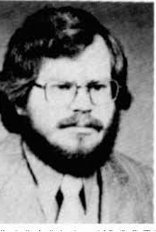
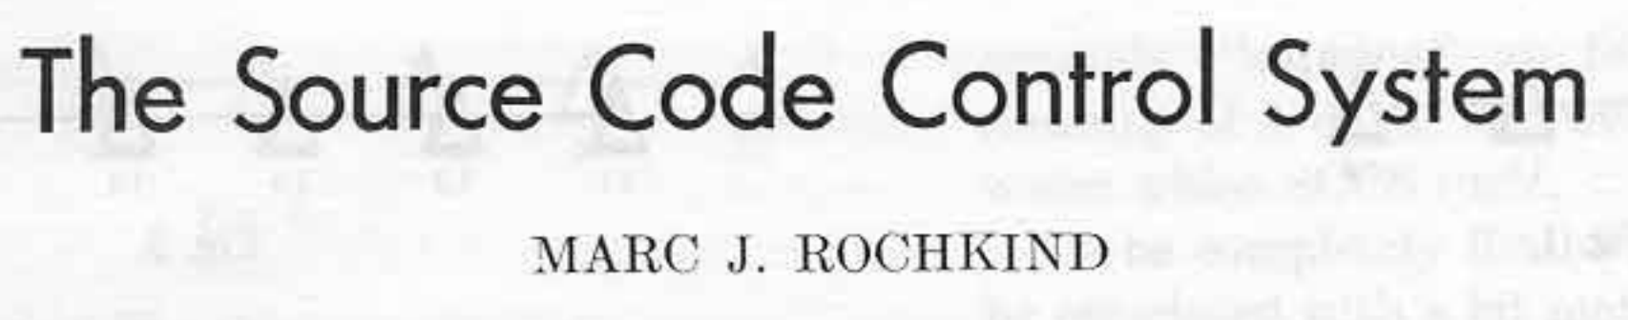
Notes:
Before we go any further though, has anybody here actually used SCCS?
The year is 1972 and Marc Rochkind is struggling to deal with change management. In his 1975 paper The Source Code Control System, he describes four problems he was trying to solve.

Slide 25
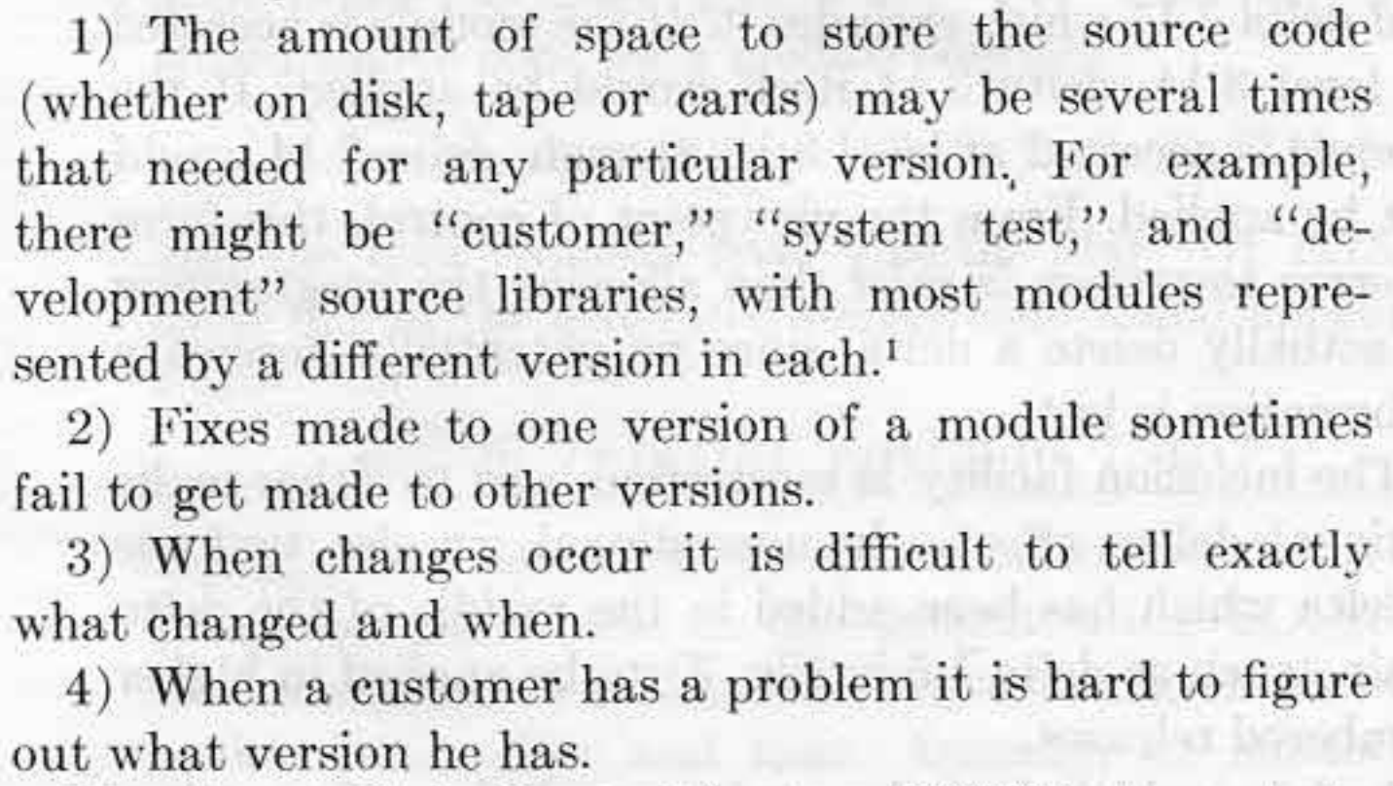
Notes:
I try not to have slides with a lot of words, but I’m making some exceptions for this talk. I just think putting up screenshots from old technical papers is really cool. Don’t feel like you need to read all of that though because we’re going to go through it. These are the problems that Marc was trying to solve in 1972.
1. The amount of space to store the source code (whether on disk, tape, or cards) may by several times that needed for any particular version.
2. Fixes made to one version of a module sometimes fail to get made to other versions.
3. When changes occur it is difficult to tell exactly what changed and when.
4. When a customer has a problem it is hard to figure out what version he has.
It's important to remember that memory was precious at this time. The size of files on disk was important, so an efficient storage format was essential.
Distribution of releases was also difficult. There was no internet. Computers were still only owned by large organizations. If you were distributing software, chances are it was an "enterprise" model and customziations for the customer were common. Dealing with versioning of all these releases was a challenge.

Slide 26
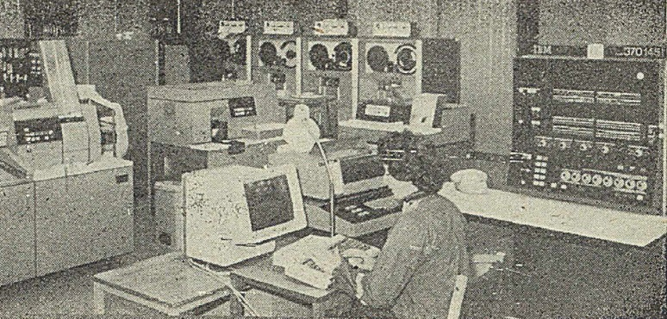
Prototype
SNOBOL: StriNg Oriented and symBOlic Language
SPITBOL: Speedy Implementation of SNOBOL
IBM System/370
OS/MVT: Multiple Programming with a Variable Number of Tasks
https://commons.wikimedia.org/wiki/File:IBM_370-145_(I198005).jpg
Notes:
The first version was writen in SNOBOL 4 using the SPITBOL compiler for an IBM System/370 running OS/MVT. That's a lot of acronyms.
> TODO: Insert picture of IBM System/370.
SNOBOL = StriNg Oriented and symBOlic Language
SPITBOL = (Speedy Implementation of SNOBOL)
IBM 370 = https://en.wikipedia.org/wiki/IBM_System/370
OS/MVT = Multiple Programming with a Variable Number of Tasks (A version of OS/360)
They felt that the concept of version control was too out there to win people over with a specification, so they prioritized ease of development. SNOBOL 4 was chosen because of it's expressive power and ease of use. For it's day it was an incredibly powerful language. One person was able to write the initial prototype in three months. Depending on the domain you work in, that might seem ridiculous by modern standards, but you have to remember that this is 1972. We stand on the shoulders of giants. This is quite a few shoulders below us.
The downside of SNOBOL 4 and SPITBOL is size and speed, but that wasn't an issue during the six month trial run.

Slide 27
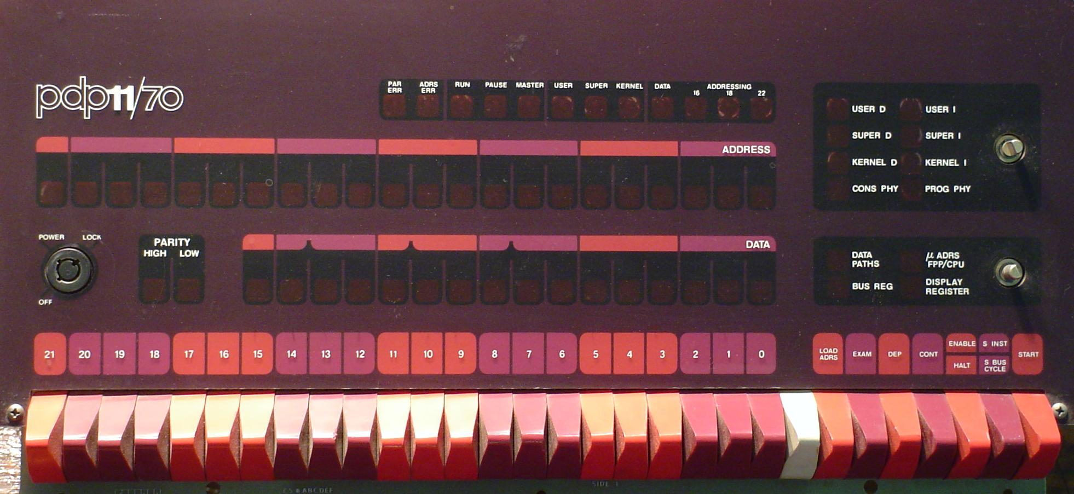
https://en.wikipedia.org/wiki/PDP-11#/media/File:Pdp-11-70-panel.jpg
Notes:
The protoype was very successful and several large appliations were using it internally. In the fall of 1973 there were several more projects interested in using SCCS and the decision was made to write a new version. The interested projects were on multiple OS's, but the existing version of SCCS only supported OS/360 still. Instead of writing different versions for each OS (which was standard operating procedure then), they decided to write just one version that would run on a PDP 11/45 under UNIX.
Source code would be stored on the PDP 11 and sent to the appropriate machine for compilation. Given the future dominance of UNIX, this turned out to be a wise decision.
This is a picture of a PDP-11/70, which was an upgraded version of the PDP-11/45.

Slide 28
Features
Single file
Locking
Release management
Notes:
So, that's all well and good, but how did SCCS work?
If you remember the features from the first generation, you’ll remember that it only works on a single file at a time, that file gets locked when checked out for editing, and there is no networking.
Working on a single file at a time will probably feel a bit alien to just about everybody in this room. Who here has used a version control system that is focused on individual files? This means your commits are limited to one file at a time. Does anybody here still use a VCS like this, such as RCS?
Release management is interesting though, so let’s talk about that a bit.

Slide 29
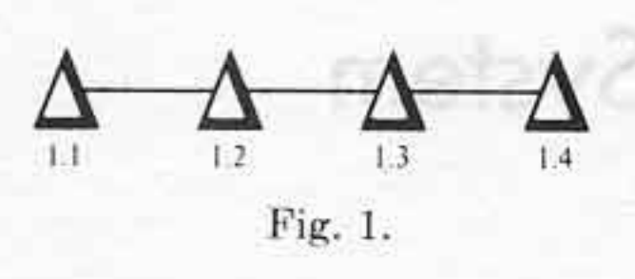
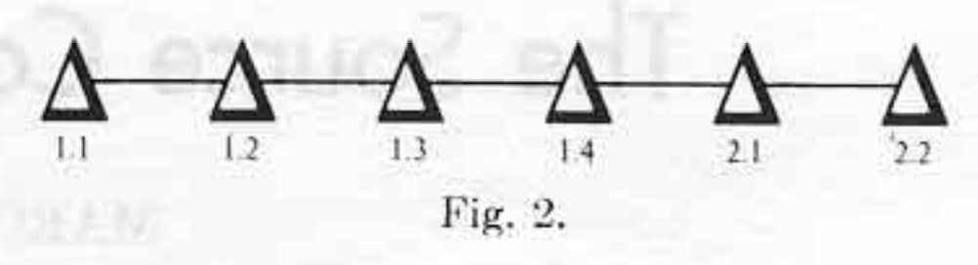
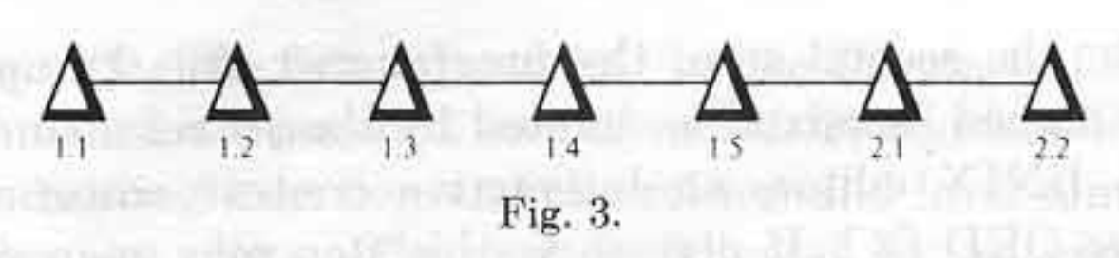
Notes:
These images are from Rochkind’s original 1975 paper, so it felt appropriate to include them to talk about releases.
I mentioned that managing the versioning of releases was a very big problem that SCCS hoped to tackle. It did this through the concept of releases and levels. Each commit would increment the level of a release. For example, when you create a file, it is at Release 1, Level 1, or 1.1. Committing a delta would increment the level to 2, so now we're at 1.2. The release number would only increment if you explicitly started a new release with `edit -r`.
You had a lot of power over managing those releases. For example, if you needed to make a fix to release 1, but release 2 is the most recent, you could explicitly checkout the latest level from release 1 and make a change. That change would not apply to release 2. You would have to make the change in release 2 by yourself if necessary. This was not actually the original behavior though. In this example, 1.5 was added. That delta would have been included in release 2. They originally thought this was a good idea, but experience taught them otherwise. This means that, in the diagram, 1.5 is NOT part of release 2 because it was added later. There’s no concept of branching here. Everything is linear.
You also had a lot of power to search and display history, but I'm not going to dive into that here.

Slide 30
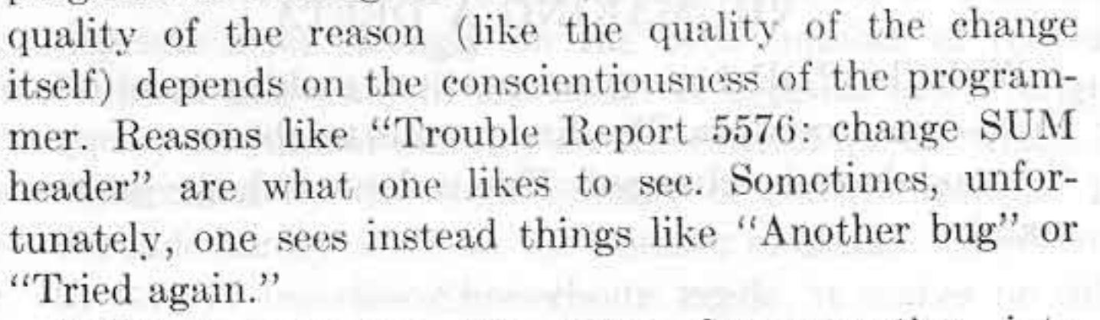
Notes:
In 2020 we have mastered informative and conscientious commit messages, right? I’m assuming none of you work on teams that commonly use commit messages like this. /sarcasm
Even in 1975 Rochkind was lamenting the lack of good commit messages.

Slide 31
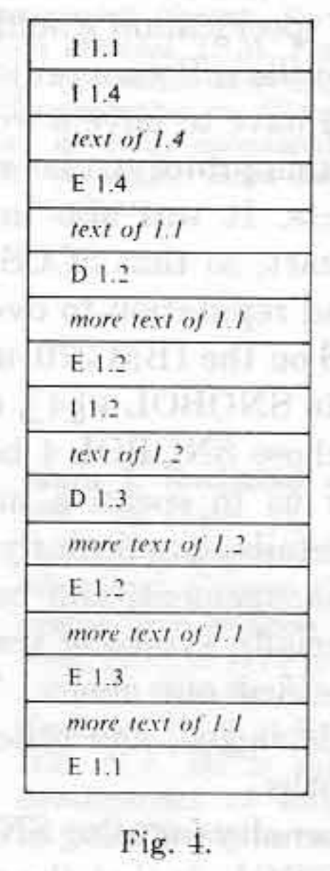
Interleaved Delta
Notes:
I don't want to dive too deep into implementation details with every system that I discuss today, but I do think it's important to talk a bit about how SCCS worked to set a baseline for comparison. Plus it's a great excuse to dive into old papers.
The core of SCCS is something called interleaved deltas. In the paper, Rochkind describes the problem he was trying to solve
“The attempt by SCCS to record every version of every module that ever existed is rather ambitious. The system would be impractical unless it used a storage technique and accessing algorithm that allowed many deltas to be kept at a reasonable cost in terms of disk space and processing time.”
Interleaved deltas satisfied both requirements. The space required to store the delta is only slightly greater then the amount of text inserted by the delta. Access speed was mostly flat. Any level could be reached in equal time.
All changes are stored with just two primitives. Lines are either being inserted or deleted. This should still be familiar today, because that is how diff works. Each module is a separate sequential file. The deltas are stored in the body. The body consists of text records and control records. Text records contain the source code. Control records specify the effects of each delta.

Slide 32

Billie Ward/Dog Walk
Notes:
In 2015, Marc Rochkind sent an email to a mailing list outlining how he came up with the algorithm for interleaved deltas. I love this story because it shows that even in 1972 computer programmers were solving thorny problems by getting away from their work. (http://sccs.sourceforge.net/sccs_invention.html)
Marc was walking his girlfriend's dog. Marc didn't like the dog, so he would let his mind wander when walking it. He had been struggling with the problem of how to store both the source code and the deltas all in the same file. He came up with the idea of surrounding the pieces of text with markers. When he got back to his apartment, he started sketching out details of how it might work.
When he thought he had a workable solution, he enumerated what he thought were all the possible cases of insertions mixed with deletions and worked through each example. From there it was pretty simple to code and he had it running in SNOBOL4 in a day or two.

Slide 33
SCCS Today
http://sccs.sourceforge.net/
Notes:
As the first "real" version control system, SCCS was obviously extremely influential, but it also had a surprisingly long life-span. The project started in 1972 but didn't have it's first public release until version 4 on February 18, 1977. It even ended up becoming part of the Single UNIX Specification. It's still part of the POSIX standard, which really makes me wonder what other sort of random, irrelevant by-today's-standards utilities are part of POSIX.
The file format is actually still (or was?) used by more modern version control systems like BitKeeper and TeamWare.
You can still find a modern fork of SCCS that was open sourced by Sun as part of OpenSolaris on SourceForge. That site is actually a treasure trove of information. For example, it contains the version 4 release announcement from 1977. It contains important information, such as SCCS files now being stored as ASCII instead of binary. We can also see that it was still being distributed as part of a larger tool suite called Programmer's Workbench (PWB).
You can also find a link to the SCCS development mailing list! It had a grand total of... one message in 2019. Asking if Windows 10 support was planned.
GNU also provides CSSC, which is their version of SCCS. The source code of course lives in a git repository. It was converted from CVS to git in 2010. There is actually one dev (James Youngman) actively making contributions to it this past year. The intent of the project is to help convert old SCCS repos over to a more modern option.

Slide 34
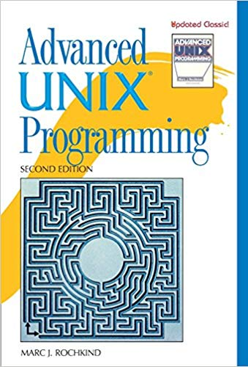
Marc Rochkind
https://basepath.com/
Notes:
Today, you can find Marc Rochkind’s work on his website. I’m not completely sure what he’s doing these days, but, based only his website, it appears that he keeps busy with a wide range of hobby projects.
Something else that will be a bit of recurring theme today is that a lot of the people I’m going to talk about or also well known for other things. In this case, it’s for Advanced UNIX Programming.

Slide 35
Generations
Generation | Networking | Operations | Concurrency | Examples
First | None | One file a time | Locks | SCCS, RCS
Second | Centralized | Multi-file | Merge before commit | CVS, SVN
Third | Decentralized | Changesets | Commit before merge | BitKeeper, Monotone, Darc, Git, Mercurial
https://ericsink.com/vcbe/html/history_of_version_control.html#ftn.idp96624

Slide 36
Generations
Generation | Networking | Operations | Concurrency | Examples
First | None | One file a time | Locks | SCCS, RCS
Second | Centralized | Multi-file | Merge before commit | CVS, SVN
Third | Decentralized | Changesets | Commit before merge | BitKeeper, Monotone, Darc, Git, Mercurial
https://ericsink.com/vcbe/html/history_of_version_control.html#ftn.idp96624

